Slide 1
Probability theory
Statistics

Slide 2

PROBABILITY THEORY AND STATISTICS
Suppose you have a fair dice. Intuitively you have 1 in 6 chance to roll a six.

Slide 3
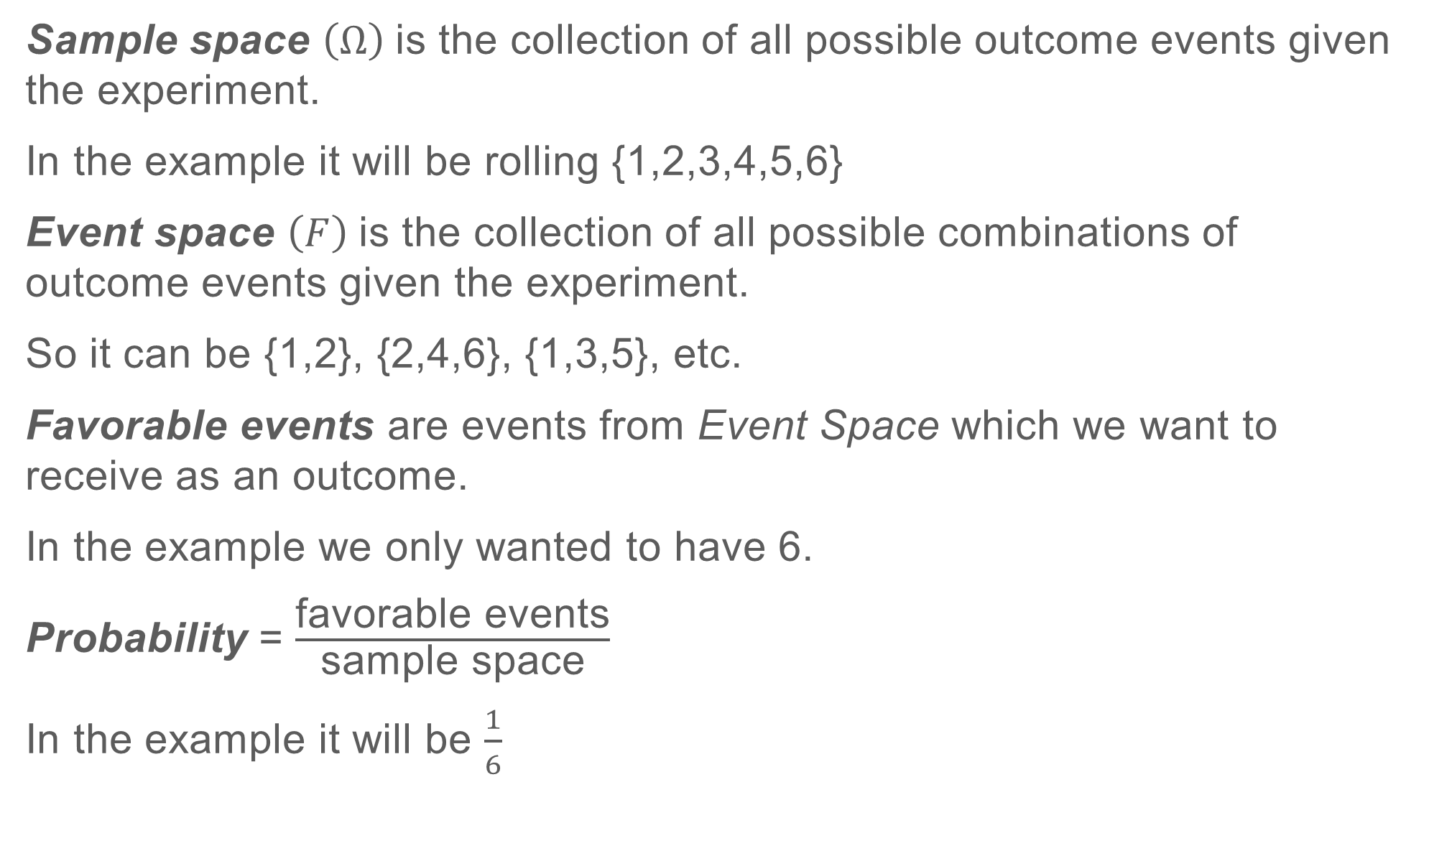
PROBABILITY THEORY AND STATISTICS
Sample space $\left(Ω\right)$is the collection of all possible outcome events given the experiment.
In the example it will be rolling {1,2,3,4,5,6}
Event space $\left(F\right)$is the collection of all possible combinations of outcome events given the experiment.
So it can be {1,2}, {2,4,6}, {1,3,5}, etc.
Favorable events are events from Event Space which we want to receive as an outcome.
In the example we only wanted to have 6.
Probability = $\frac{\text{favorable} \text{events}}{\text{sample} \text{space}}$
In the example it will be $\frac{1}{6}$

Slide 4
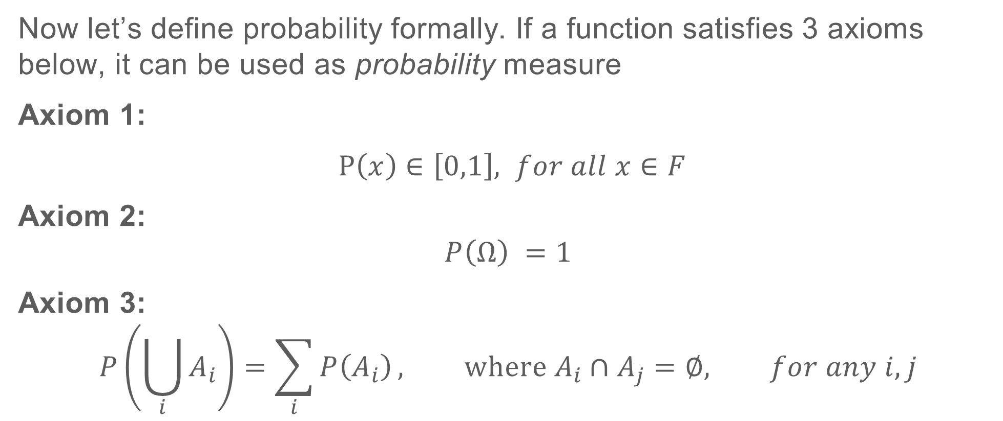
PROBABILITY THEORY AND STATISTICS
Now let’s define probability formally. If a function satisfies 3 axioms below, it can be used as probability measure
Axiom 1:
$P\left(x\right)∈\left[0,1\right], for all x∈F$
Axiom 2:
$$P\left(Ω\right) =1$$
Axiom 3:
$$P\left(\bigcup_{i}{A_{i}}\right)=\sum_{i}{P\left(A_{i}\right)}, where A_{i}∩A_{j}=∅, for any i,j$$
Some examples. https://www.mathsisfun.com/data/probability.html

Slide 5
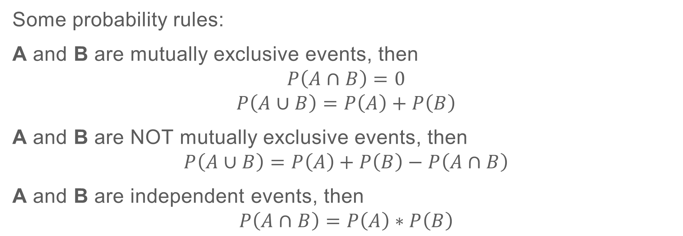
PROBABILITY THEORY AND STATISTICS
Some probability rules:
A and B are mutually exclusive events, then
$$P\left(A∩B\right)=0$$
$$P\left(A∪B\right)=P\left(A\right)+P\left(B\right)$$
A and B are NOT mutually exclusive events, then
$$P\left(A∪B\right)=P\left(A\right)+P\left(B\right)−P\left(A∩B\right)$$
A and B are independent events, then
$$P\left(A∩B\right)=P\left(A\right)∗P\left(B\right)$$
Some examples. https://people.richland.edu/james/lecture/m170/ch05-rul.html

Slide 6
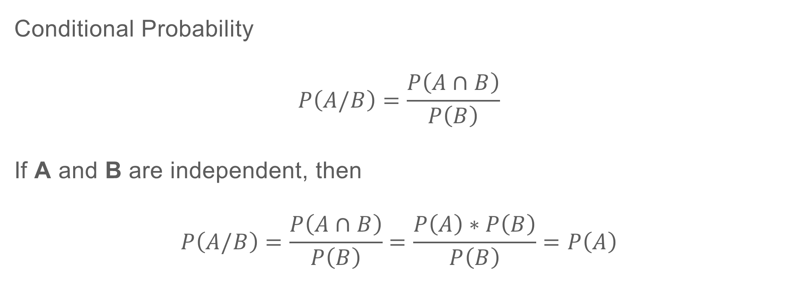
PROBABILITY THEORY AND STATISTICS
Conditional Probability
$$P\left(A/B\right)=\frac{P\left(A∩B\right)}{P\left(B\right)}$$
If A and B are independent, then
$$P\left(A/B\right)=\frac{P\left(A∩B\right)}{P\left(B\right)}=\frac{P\left(A\right)∗P\left(B\right)}{P\left(B\right)}=P\left(A\right)$$
Some examples. https://www.mathsisfun.com/data/probability-events-conditional.html
Notes:
Bring example about types of firing gun. (when a firing happens some type of gun will follow with ore probability than just without initial firing)./

Slide 7
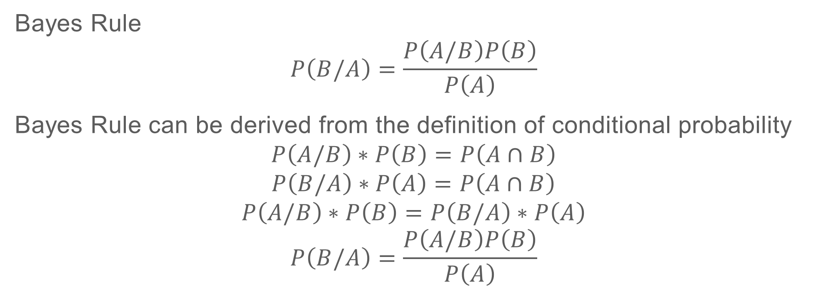
PROBABILITY THEORY AND STATISTICS
Bayes Rule
$$P\left(B/A\right)=\frac{P\left(A/B\right)P\left(B\right)}{P\left(A\right)}$$
Bayes Rule can be derived from the definition of conditional probability
$$P\left(A/B\right)∗P\left(B\right)=P\left(A∩B\right)$$
$$P\left(B/A\right)∗P\left(A\right)=P\left(A∩B\right)$$
$$P\left(A/B\right)∗P\left(B\right)=P\left(B/A\right)∗P\left(A\right)$$
$$P\left(B/A\right)=\frac{P\left(A/B\right)P\left(B\right)}{P\left(A\right)}$$
Monty Hall problem: http://wwwf.imperial.ac.uk/~atw/Bayes.pdf
Notes:
Bring example about probability of attack when there is movement in enemy units

Slide 8
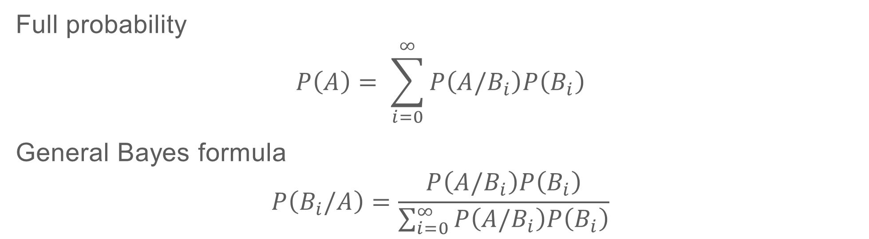
PROBABILITY THEORY AND STATISTICS
Full probability
$$P\left(A\right)= \sum_{i=0}^{∞}{P\left(A/B_{i}\right)P\left(B_{i}\right)}$$
General Bayes formula
$$P\left(B_{i}/A\right)=\frac{P\left(A/B_{i}\right)P\left(B_{i}\right)}{\sum_{i=0}^{∞}{P\left(A/B_{i}\right)P\left(B_{i}\right)}}$$
Notes:
Bring example about probability of attack when there is movement in enemy units

Slide 9
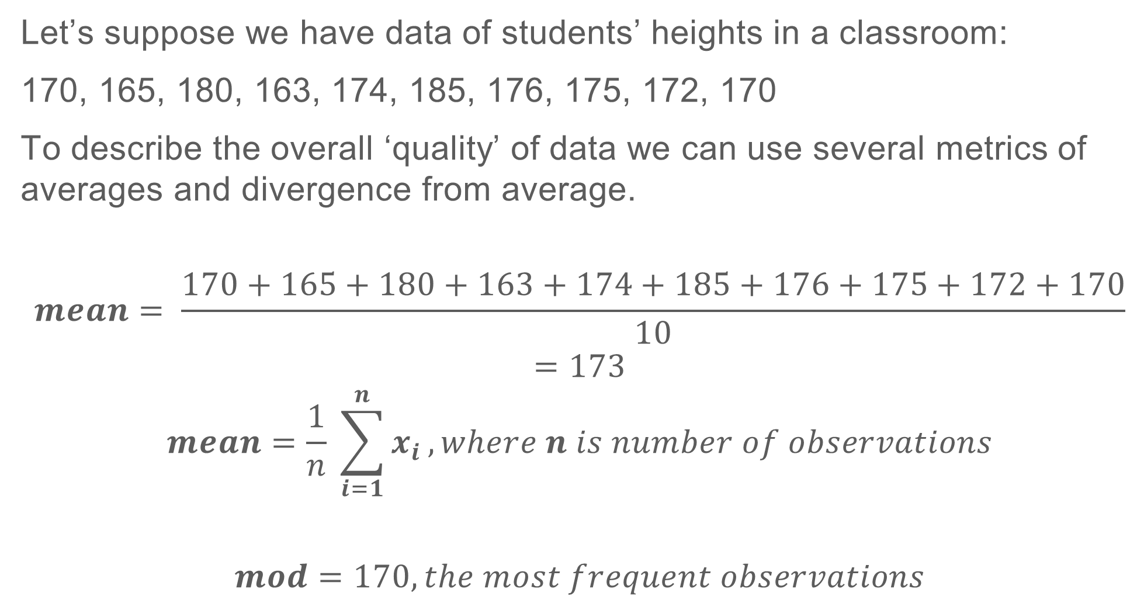
PROBABILITY THEORY AND STATISTICS
Let’s suppose we have data of students’ heights in a classroom:
170, 165, 180, 163, 174, 185, 176, 175, 172, 170
To describe the overall ‘quality’ of data we can use several metrics of averages and divergence from average.
$$mean= \frac{170+165+180+163+174+185+176+175+172+170}{10}=173$$
$$mean=\frac{1}{n} \sum_{i=1}^{n}{x_{i}}, where n is number of observations$$
$$mod=170, the most frequent observations$$
Notes:
Bring example on firings data for mean and mod

Slide 10
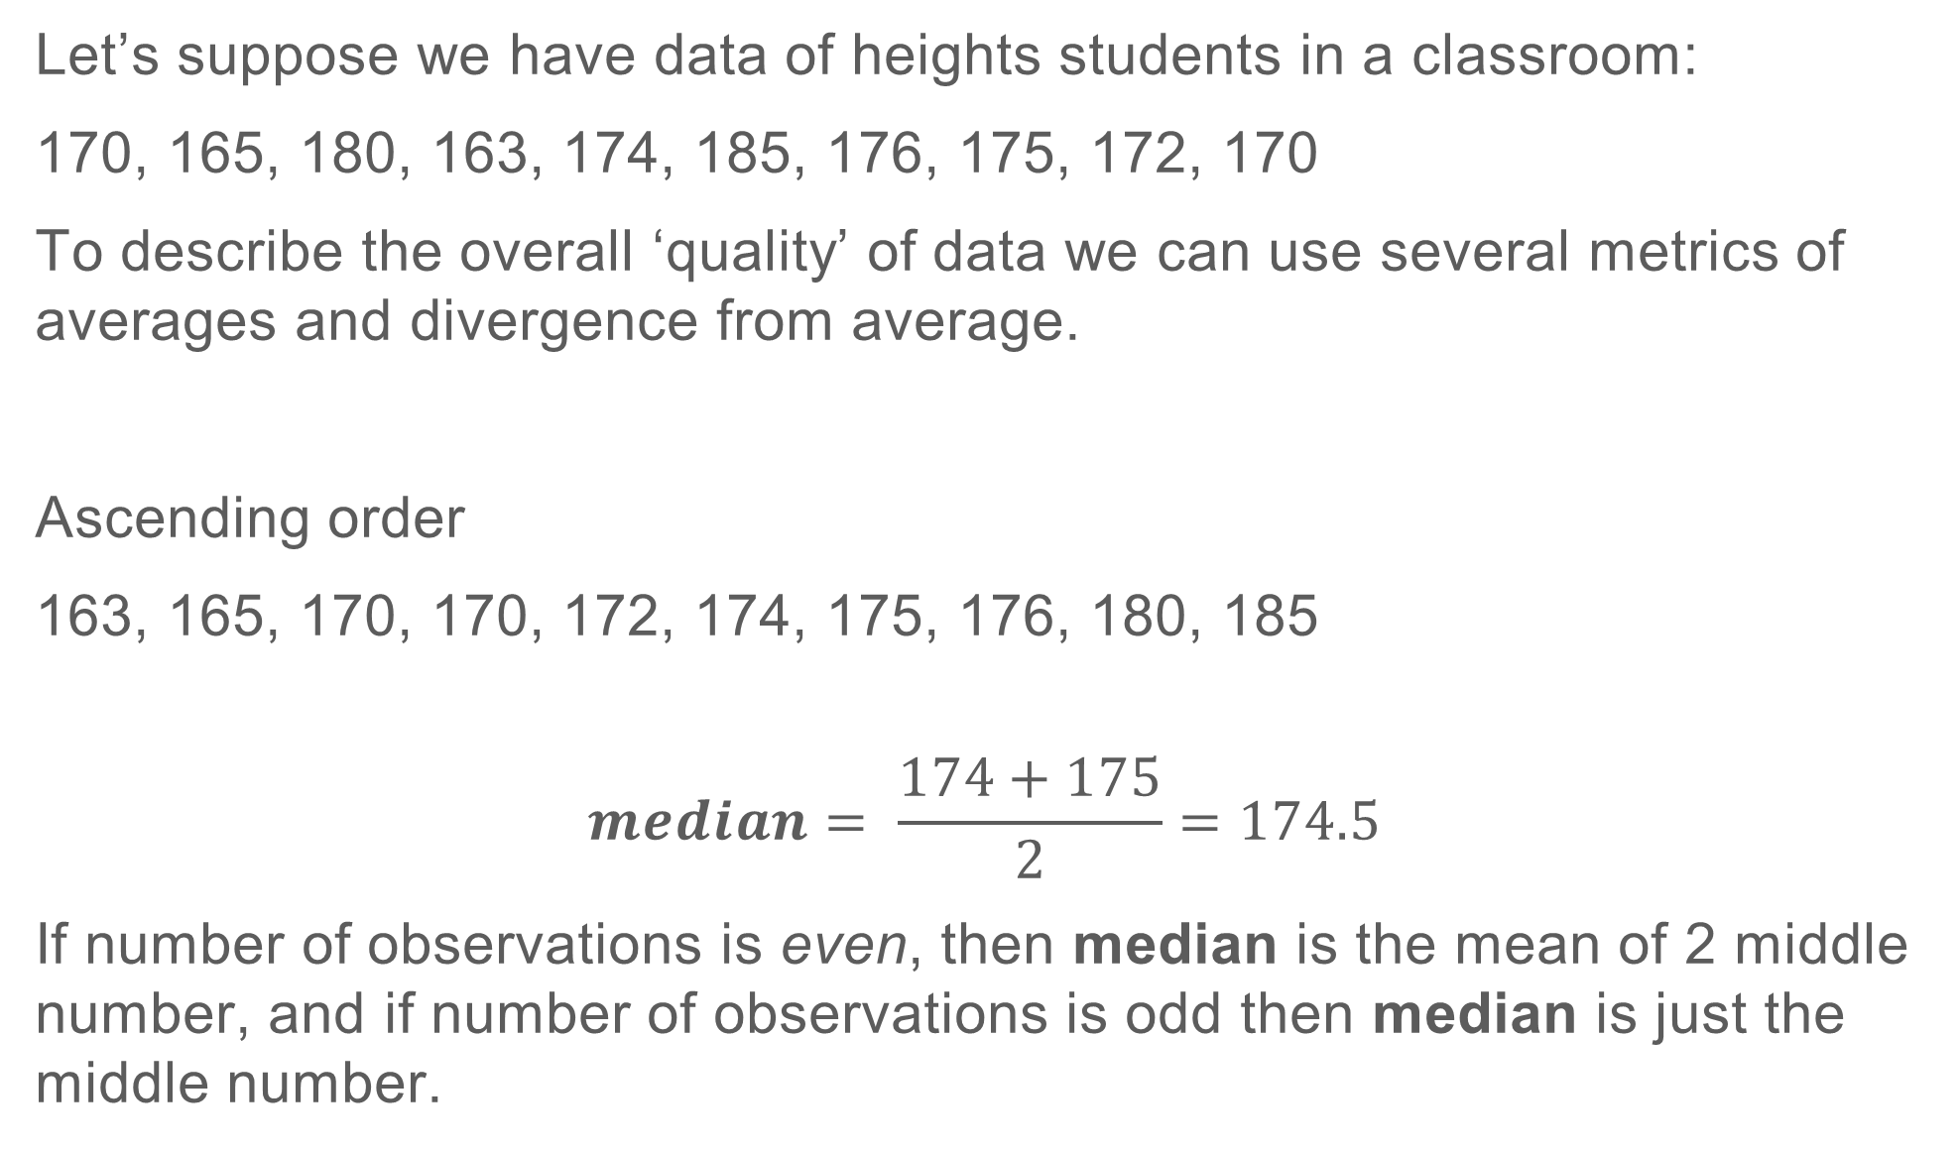
PROBABILITY THEORY AND STATISTICS
Let’s suppose we have data of heights students in a classroom:
170, 165, 180, 163, 174, 185, 176, 175, 172, 170
To describe the overall ‘quality’ of data we can use several metrics of averages and divergence from average.
Ascending order
163, 165, 170, 170, 172, 174, 175, 176, 180, 185
$$median= \frac{174+175}{2}=174.5$$
If number of observations is even, then median is the mean of 2 middle number, and if number of observations is odd then median is just the middle number.
Notes:
And median

Slide 11
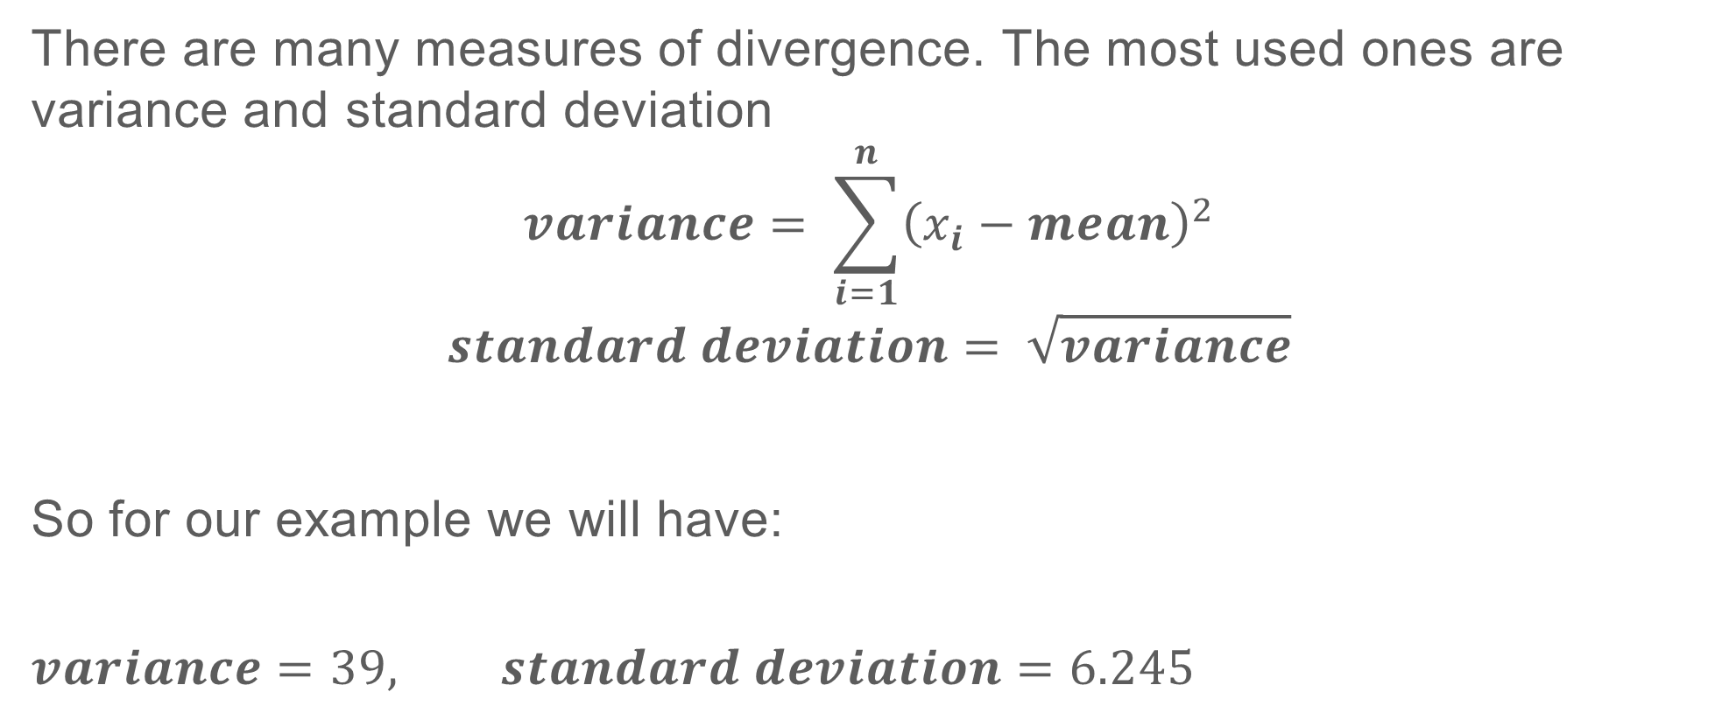
PROBABILITY THEORY AND STATISTICS
There are many measures of divergence. The most used ones are variance and standard deviation
$$variance= \sum_{i=1}^{n}{{\left(x_{i}−mean\right)}^{2}}$$
$$standard deviation= \sqrt{variance}$$
So for our example we will have:
$$variance=39, standard deviation=6.245$$
Notes:
And standard deviation variance

Slide 12
PROBABILITY THEORY AND STATISTICS
Suppose we need to roll 2 dices and calculate the sum of numbers showing up. A convenient idea for estimating overall properties of this event is random variable. It’s numerical measure that maps the events to some numbers.
The minimum could be 2, and maximum could be 12, so our random variable can take values from 2 to 12 (Note that you can assign any number to the events , e.g. even number from 4-24 or entirely random numbers for each sum case).
Notes:
And median

Slide 13
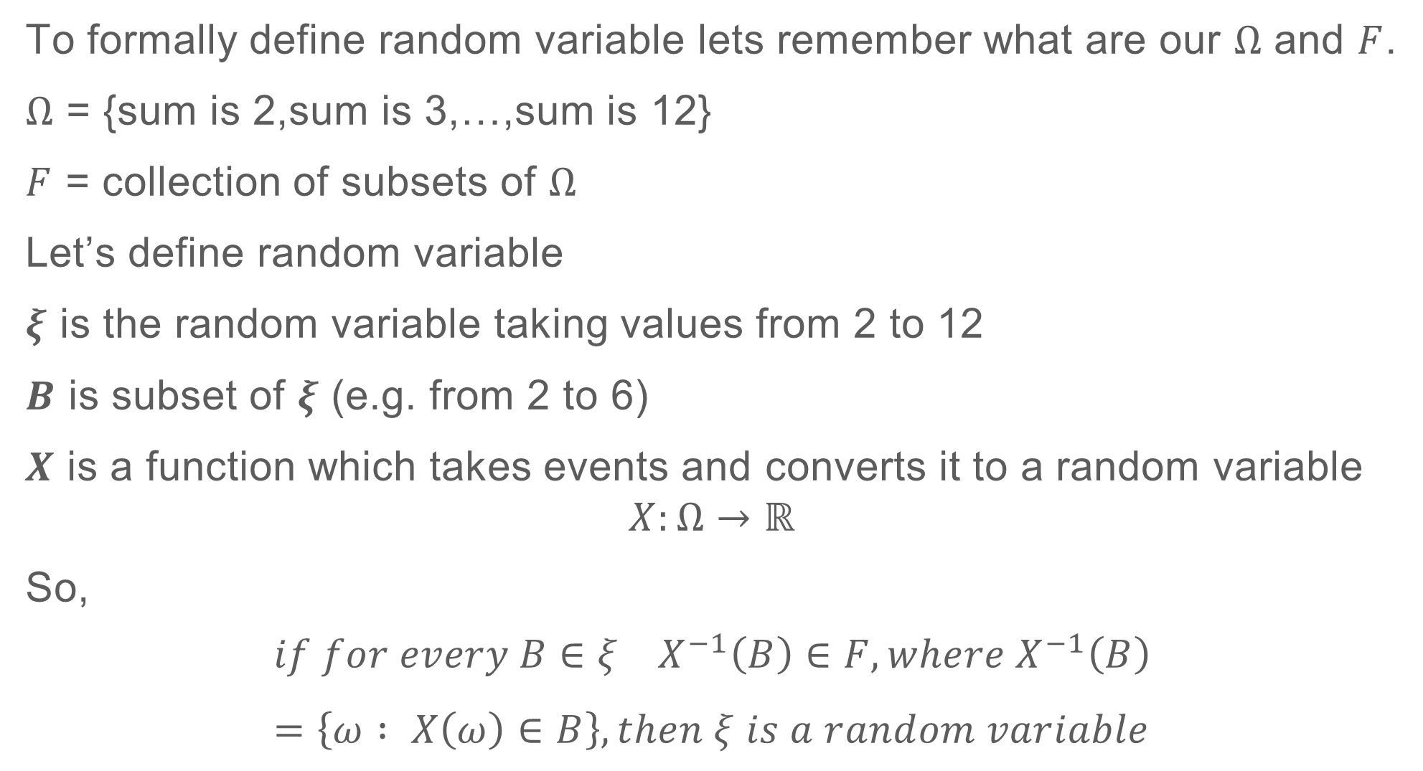
PROBABILITY THEORY AND STATISTICS
To formally define random variable lets remember what are our $Ω$ and $F$.
$Ω$ = {sum is 2,sum is 3,…,sum is 12}
$F$ = collection of subsets of $Ω$
Let’s define random variable
$ξ$ is the random variable taking values from 2 to 12
$Β$ is subset of $ξ$ (e.g. from 2 to 6)
$Χ$ is a function which takes events and converts it to a random variable
$$X:Ω→ℝ$$
So,
$$if for every Β∈ξ Χ^{−1}\left(Β\right)∈F, where{ Χ}^{−1}\left(Β\right)=\left\{ω : X\left(ω\right)∈B\right\}, then ξ is a random variable$$
Notes:
And median

Slide 14
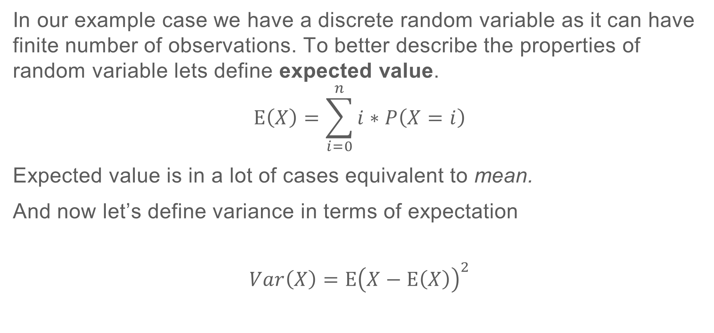
PROBABILITY THEORY AND STATISTICS
In our example case we have a discrete random variable as it can have finite number of observations. To better describe the properties of random variable lets define expected value.
$$E\left(X\right)=\sum_{i=0}^{n}{i∗P\left(X=i\right)}$$
Expected value is in a lot of cases equivalent to mean.
And now let’s define variance in terms of expectation
$$Var\left(X\right)=E{\left(X−E\left(X\right)\right)}^{2}$$
Notes:
And standard deviation variance

Slide 15
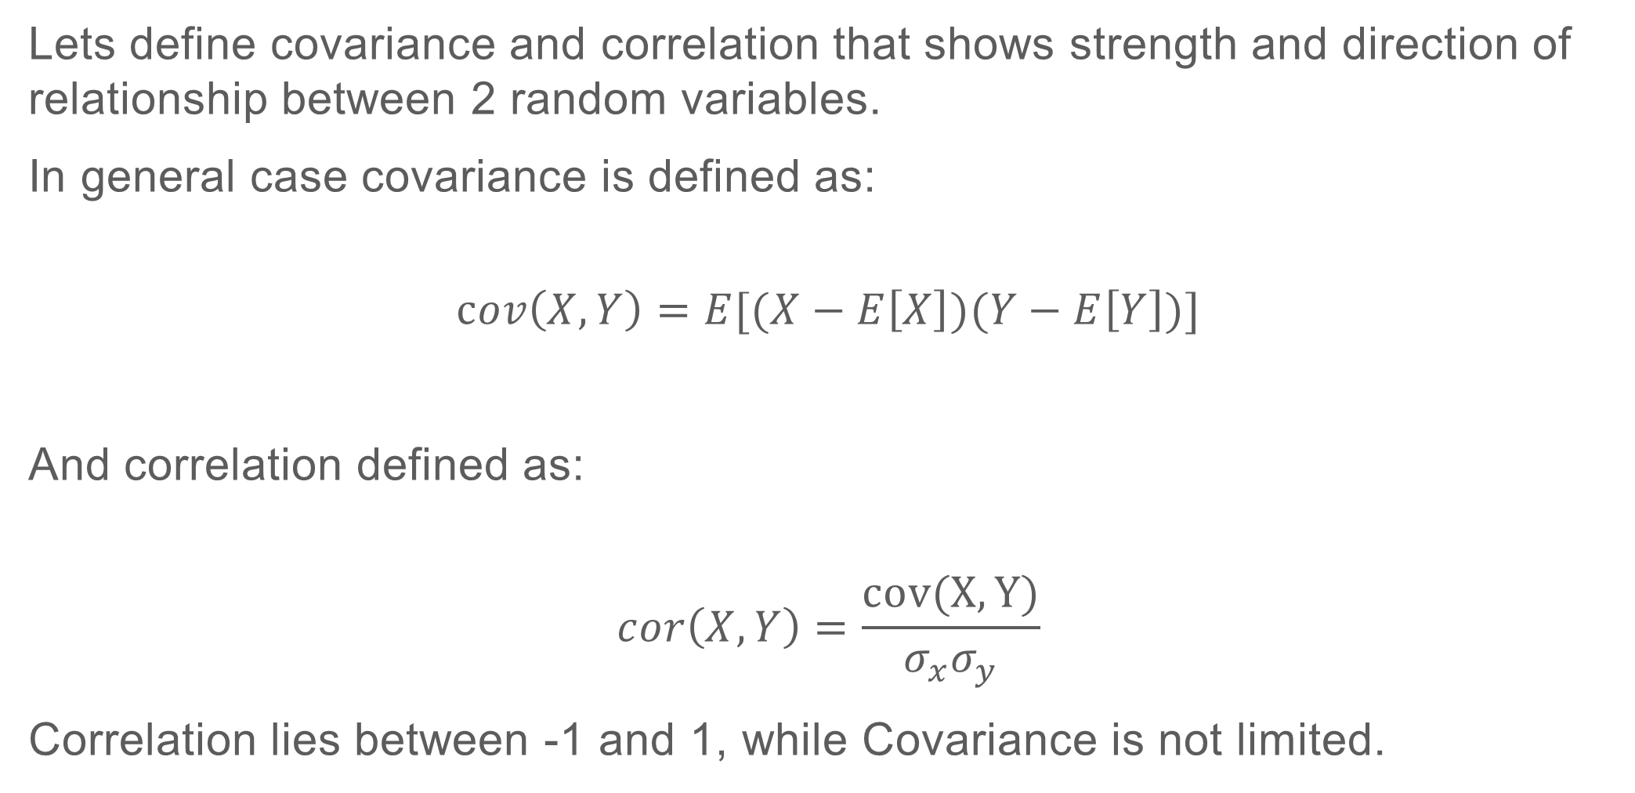
PROBABILITY THEORY AND STATISTICS
Lets define covariance and correlation that shows strength and direction of relationship between 2 random variables.
In general case covariance is defined as:
$$cov\left(X,Y\right)=E[(X−E\left[X\right])(Y−E\left[Y\right])]$$
And correlation defined as:
$$cor\left(X,Y\right)=\frac{cov(X,Y)}{σ_{x}σ_{y}}$$
Correlation lies between -1 and 1, while Covariance is not limited.
Notes:
And standard deviation variance

Slide 16
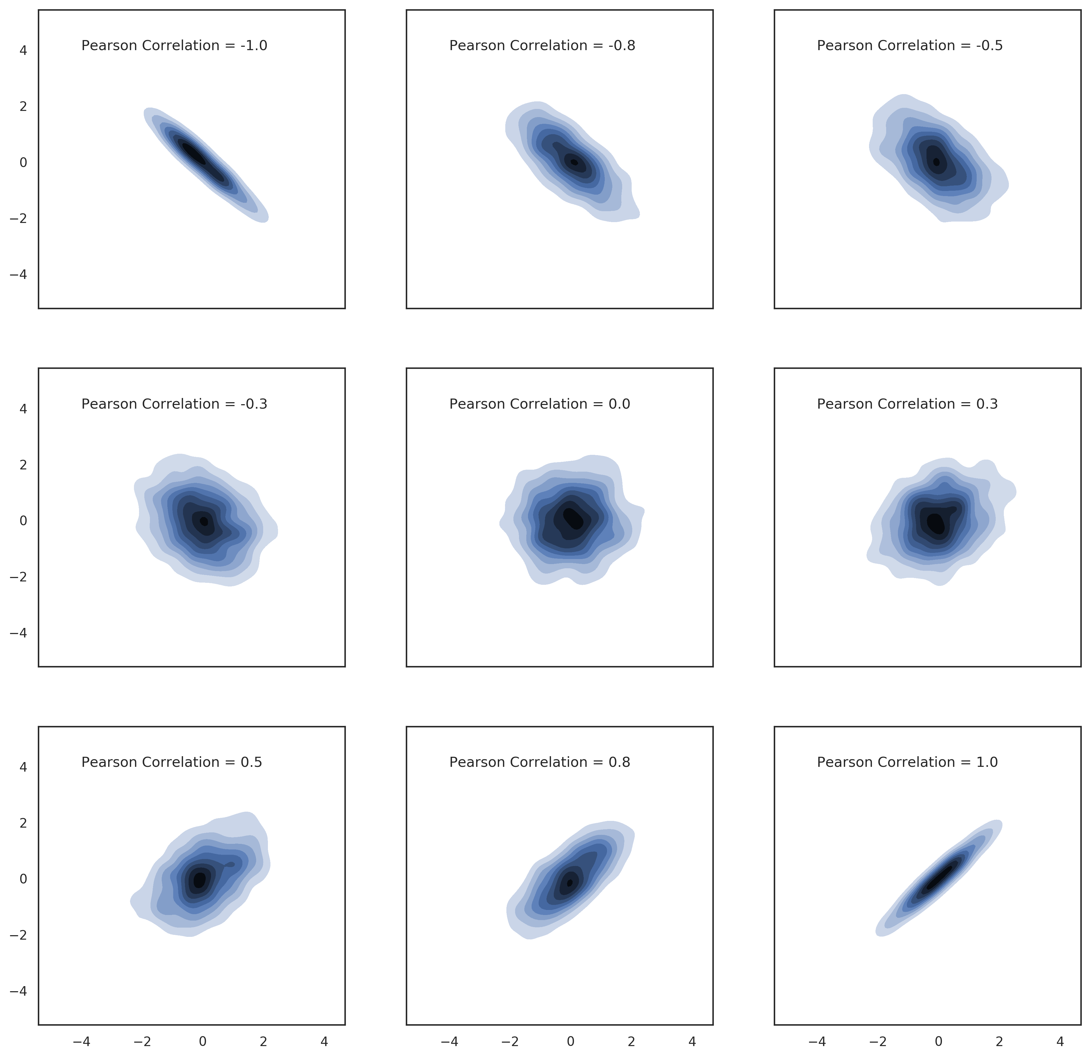
PROBABILITY THEORY AND STATISTICS
Notes:
And standard deviation variance

Slide 17
PROBABILITY THEORY AND STATISTICS
Continuous random variables can be extended from discrete random variables be introducing the idea of probability distributions.
Suppose you are throw a dart on blue circle below. The probability that it would fall at a particular dot is very small. We could say it is tending to 0.
Notes:
And standard deviation variance

Slide 18
PROBABILITY THEORY AND STATISTICS
Now if we would like to know what is the probability of dart falling above the line, then it is more intuitive that the probability is not as small as in dot case.
Notes:
And standard deviation variance

Slide 19
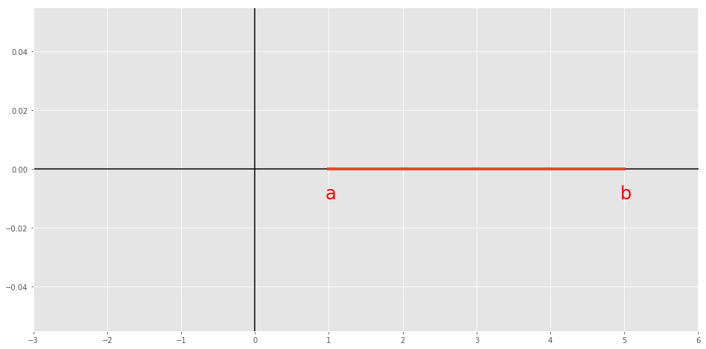
PROBABILITY THEORY AND STATISTICS
Now Let’s only consider a line for our dart throwing.
Notes:
And standard deviation variance

Slide 20
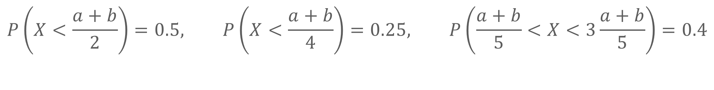
PROBABILITY THEORY AND STATISTICS
$$P\left(X<\frac{a+b}{2}\right)=0.5, P\left(X<\frac{a+b}{4}\right)=0.25, P\left(\frac{a+b}{5}<X<3\frac{a+b}{5}\right)=0.4$$
Notes:
And standard deviation variance

Slide 21
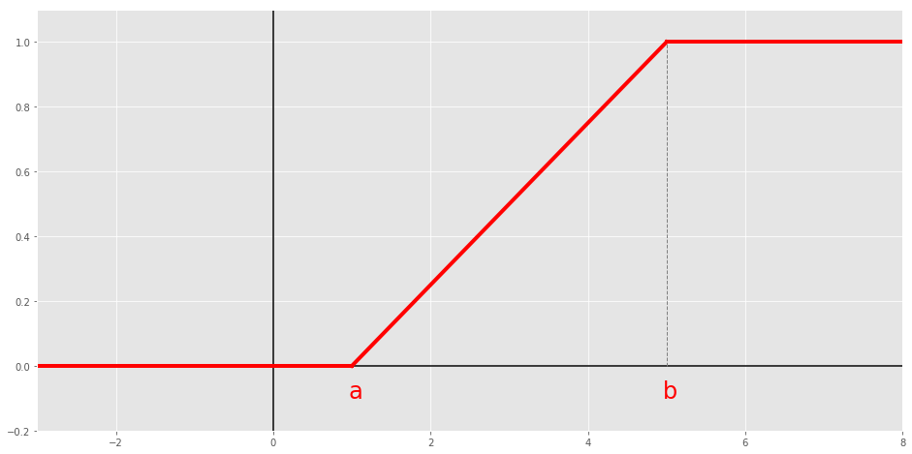
PROBABILITY THEORY AND STATISTICS
So the probability function will have the following shape.
Notes:
And standard deviation variance

Slide 22
PROBABILITY THEORY AND STATISTICS
This is called cumulative distribution function (cdf). It gives the probability of X being less than some number.
Notes:
And standard deviation variance

Slide 23
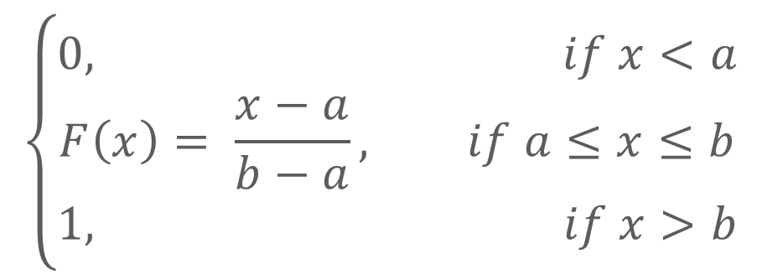
PROBABILITY THEORY AND STATISTICS
In this case this a cdf of a random variable from uniform distribution.
$$\left\{\begin{matrix}0, if x<a \\ F\left(x\right)= \frac{x−a}{b−a}, if a≤x≤b \\ 1, if x>b\end{matrix}\right.$$
Notes:
And standard deviation variance

Slide 24
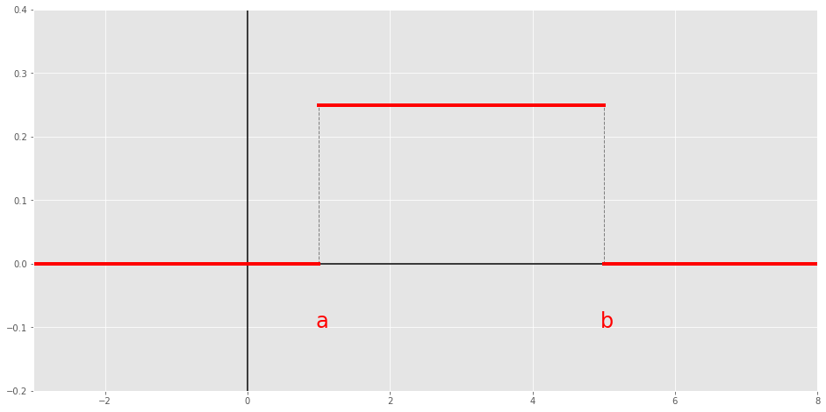
PROBABILITY THEORY AND STATISTICS
Another term is probability density function (pdf). Which is equivalent idea for point probabilities in discrete case
Notes:
And standard deviation variance

Slide 25
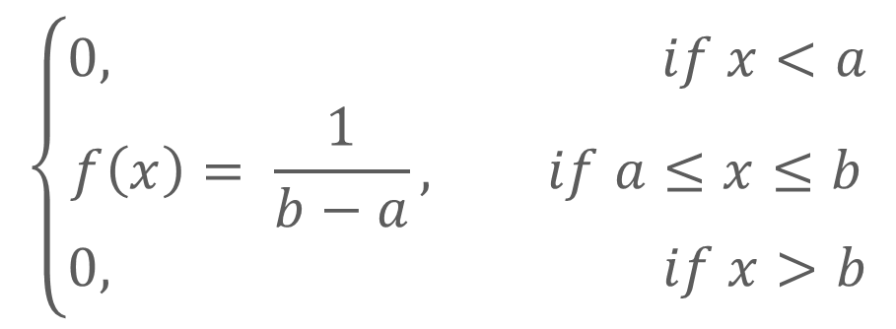
PROBABILITY THEORY AND STATISTICS
It can be understood as relative likelihood of points. In uniform case each point has equal likelihood
$$\left\{\begin{matrix}0, if x<a \\ f\left(x\right)= \frac{1}{b−a}, if a≤x≤b \\ 0, if x>b\end{matrix}\right.$$
Notes:
And standard deviation variance

Slide 26

PROBABILITY THEORY AND STATISTICS
Cdf and pdf are linked. Specifically
$$P\left(X<x\right)= F\left(x\right)= \int_{−∞}^{x}{f\left(x\right)}dx$$
$$P\left(y<X<x\right)= F\left(x\right)−F(y)= \int_{y}^{x}{f\left(x\right)}dx$$
$$\int_{−∞}^{+∞}{f\left(x\right)}dx=1$$
$$f\left(x\right)≥0$$
Notes:
And standard deviation variance

Slide 27
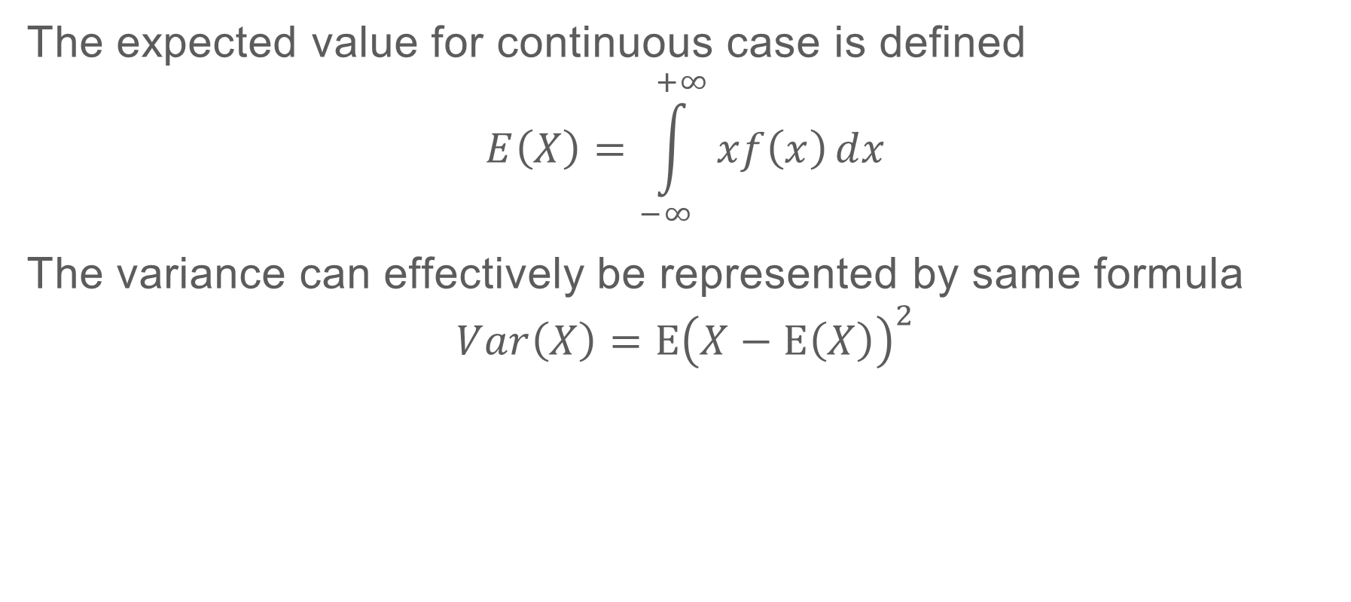
PROBABILITY THEORY AND STATISTICS
The expected value for continuous case is defined
$$E\left(X\right)=\int_{−∞}^{+∞}{xf\left(x\right)}dx$$
The variance can effectively be represented by same formula
$$Var\left(X\right)=E{\left(X−E\left(X\right)\right)}^{2}$$
Notes:
And standard deviation variance

Slide 28

PROBABILITY THEORY AND STATISTICS
For Uniform case:
$$E\left(X\right)=\int_{a}^{b}{x\frac{1}{b−a}}dx={\left.\frac{x^{2}}{2\left(b−a\right)}\right|}_{a}^{b}=\frac{b^{2}−a^{2}}{2\left(b−a\right)}=\frac{\left(b−a\right)\left(b+a\right)}{2\left(b−a\right)}==\frac{\left(b+a\right)}{2}$$
$$Var\left(X\right)= \frac{{\left(b−a\right)}^{2}}{12}, prove this!$$
Notes:
And standard deviation variance

Slide 29
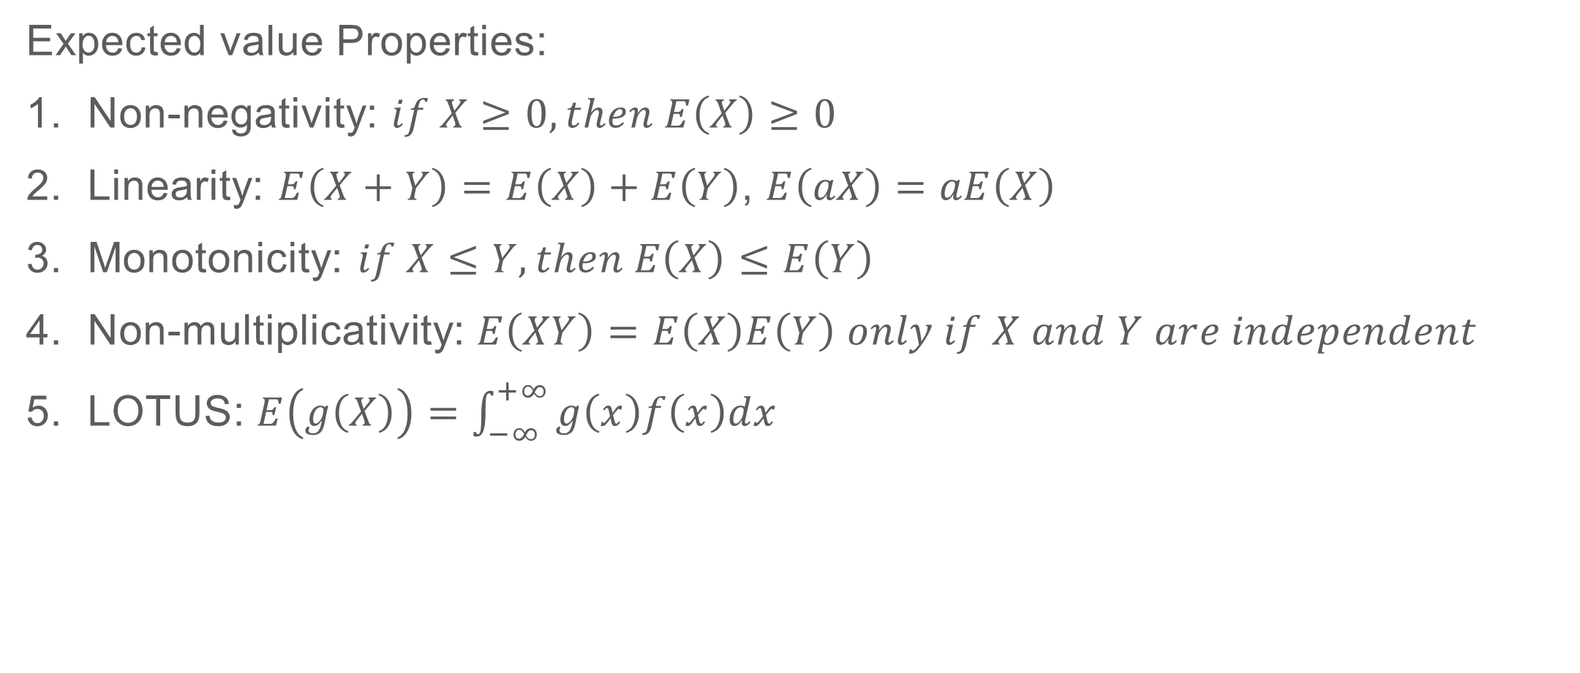
PROBABILITY THEORY AND STATISTICS
Expected value Properties:
Non-negativity: $if X≥0, then E\left(X\right)≥0$
Linearity: $E\left(X+Y\right)=E\left(X\right)+E\left(Y\right)$, $E\left(aX\right)=aE\left(X\right)$
Monotonicity: $if X≤Y, then E\left(X\right)≤E\left(Y\right)$
Non-multiplicativity: $E\left(XY\right)=E\left(X\right)E\left(Y\right) only if X and Y are independent$
LOTUS: $E\left(g\left(X\right)\right)=\int_{−∞}^{+∞}{g\left(x\right)f\left(x\right)dx}$
Notes:
And standard deviation variance

Slide 30
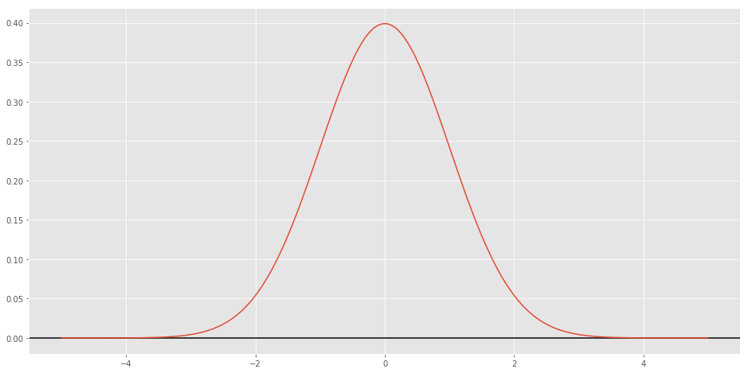

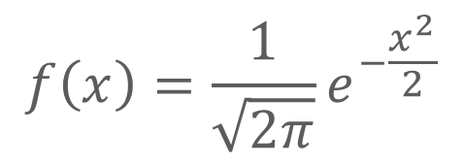
PROBABILITY THEORY AND STATISTICS
Standard Normal (Gaussian) pdf
$$N\left(0,1\right)$$
$$f\left(x\right)=\frac{1}{\sqrt{2π}}e^{−\frac{x^{2}}{2}}$$
Notes:
And standard deviation variance

Slide 31
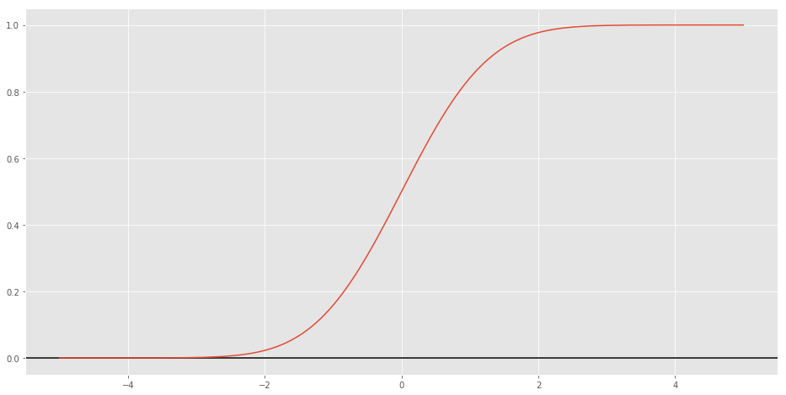

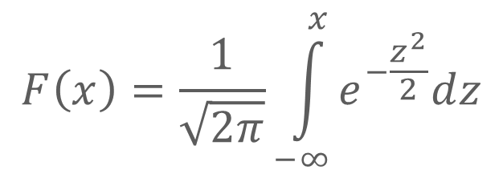
PROBABILITY THEORY AND STATISTICS
Standard Normal (Gaussian) cdf
$$N\left(0,1\right)$$
$$F\left(x\right)=\frac{1}{\sqrt{2π}}\int_{−∞}^{x}{e^{−\frac{z^{2}}{2}}dz}$$
Notes:
And standard deviation variance

Slide 32
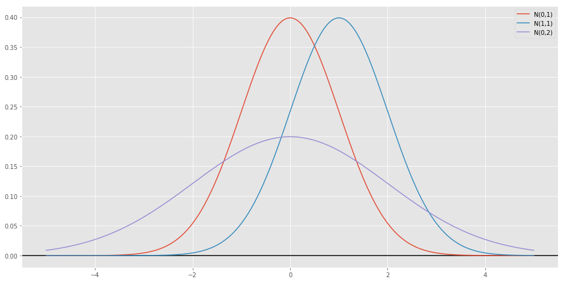

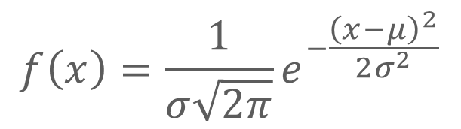
PROBABILITY THEORY AND STATISTICS
Normal (Gaussian) pdf
$$N\left(μ,σ\right)$$
$$f\left(x\right)=\frac{1}{σ\sqrt{2π}}e^{−\frac{{\left(x−μ\right)}^{2}}{2σ^{2}}}$$
Notes:
And standard deviation variance

Slide 33
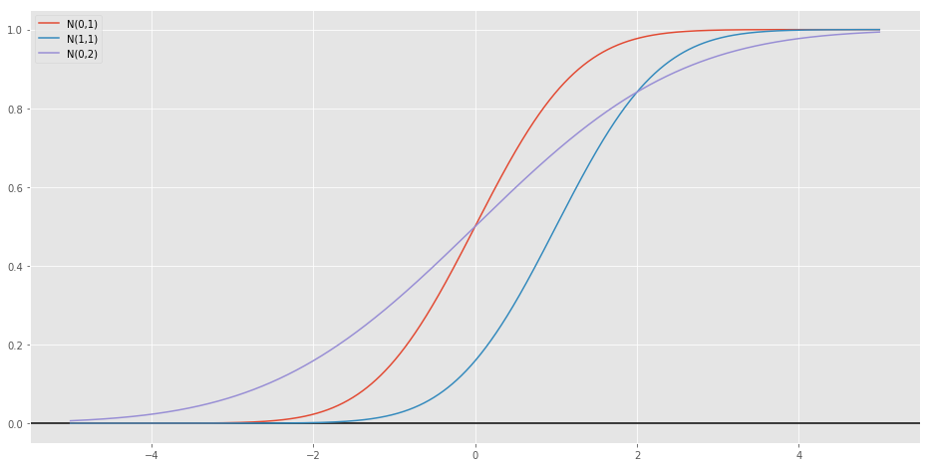

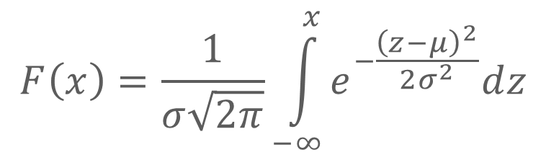
PROBABILITY THEORY AND STATISTICS
Normal (Gaussian) cdf
$$N\left(μ,σ\right)$$
$$F\left(x\right)=\frac{1}{σ\sqrt{2π}}\int_{−∞}^{x}{e^{−\frac{{\left(z−μ\right)}^{2}}{2σ^{2}}}dz}$$
Notes:
And standard deviation variance

Slide 34
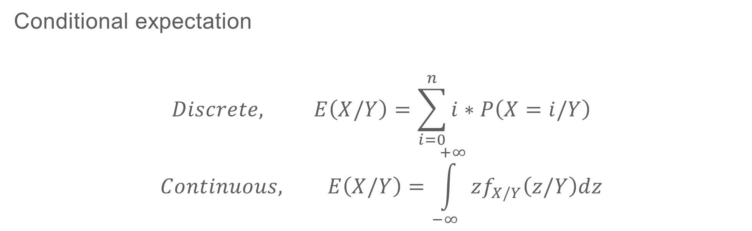
PROBABILITY THEORY AND STATISTICS
Conditional expectation
$$Discrete, E\left(X/Y\right)=\sum_{i=0}^{n}{i∗P\left(X=i/Y\right)}$$
$$Continuous, E\left(X/Y\right)=\int_{−∞}^{+∞}{zf_{X/Y}\left(z/Y\right)dz}$$
Law of Iterated expectations
$$E\left(E\left(X/Y\right)\right)=E\left(X\right)$$
Notes:
And standard deviation variance

Slide 35
PROBABILITY THEORY AND STATISTICS
Conditional expectation
http://setosa.io/conditional/
Notes:
And standard deviation variance

Slide 36
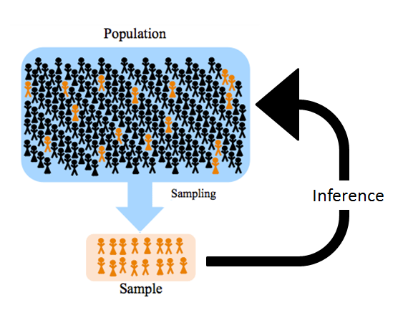
PROBABILITY THEORY AND STATISTICS
Notes:
And standard deviation variance

Slide 37
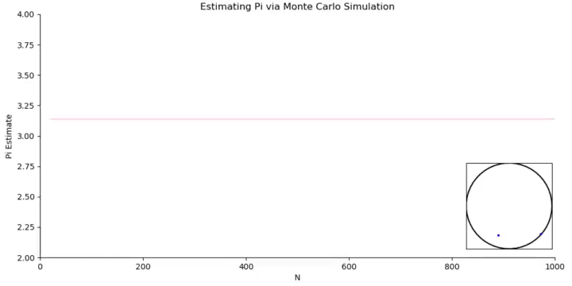
PROBABILITY THEORY AND STATISTICS
Source: https://i.imgur.com/cPSPP0w.gifv,
https://www.reddit.com/r/visualizedmath/comments/8ikuj6/estimating_pi_via_monte_carlo_simulation_oc/
Notes:
And standard deviation variance

Slide 38
PROBABILITY THEORY AND STATISTICS
Pseudo-code
for i in range(n):
generate pair x,y uniformly
calculate the distance from the center of the circle identify if it is out or not
estimate the area of circle using proportions of samples
using area estimate update the value of Pi
Notes:
And standard deviation variance

